Slide 1

Trade, Standards & Poverty
(High Value Supply Chains and Poor Farmers)
Jo Swinnen
University of Leuven
BASIS Washington DC Sept 2011

Slide 2
Issues / Motivation
Conflicting evidence on effects on farmers of
  “supermarket revolution” (FDI)
  trade & standards
Liberalization caused very different effects
  Across countries
  Across sectors (even within agriculture)
  => key issue is “endogenous institutional development” in liberalized environment

Slide 3
“Private agricultural marketing companies have become dominant providers of smallholder input credit in Africa.
In various countries of the region, they are today in practice the sole providers of seasonal input advances to the
small-scale farming community.”
IFAD (2003, p.5)

Slide 4
“Trade credit from suppliers comprised virtually all of the family farm credit and the biggest share of liabilities of agricultural companies
[in Baltics in 2004].”
World Bank (2005)

Slide 5
presentation
Changes
  fdi & retail
  trade
  standards
Effects
  horticultural exports : 3 models
  biofuels

Slide 6
Private investment and FDI
FDI flows compared to ODA flows to developing countries, 1970 - 2006
Source: Calculated from UNCTAD
Notes:
6

Slide 7
Private investment and FDI
FDI stocks as percentage of GDP, 1980 – 2006
Source: Calculated from UNCTAD

Slide 8
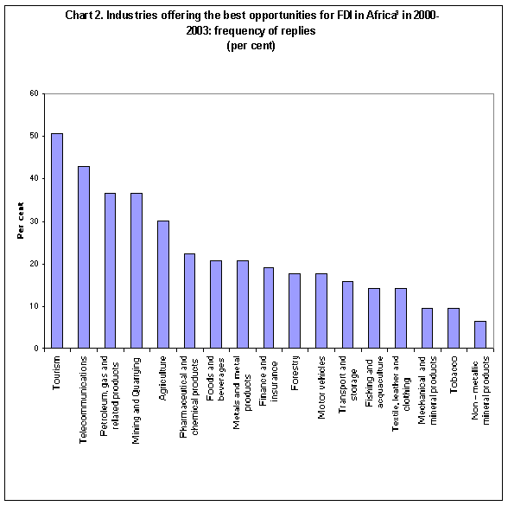
Industries offering the best opportunities for FDI in SSA
Source: UNCTAD
Notes:
8

Slide 9
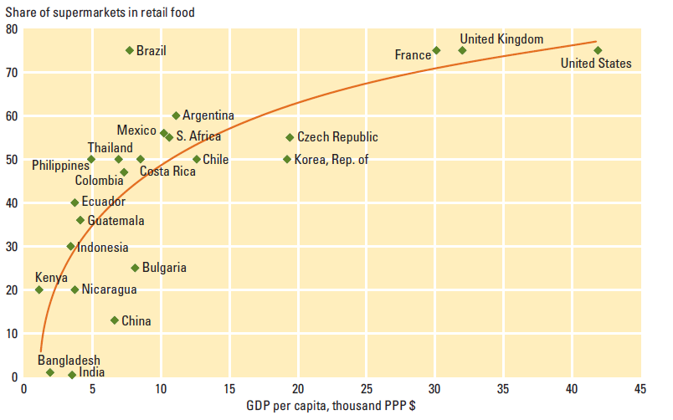
The supermarket revolution
Supermarket food retail increases with per capita income
Source: World Development Report 2008 (p 125)
Notes:
9

Slide 10
China: The Retail Olympics
Number
Sales (billion US$)
20% annual growth between 1998 and 2002
40% annual growth between 1998 and 2002
Notes:
10

Slide 11
The supermarket revolution
Supermarkets in developing countries (% of food retail)
Notes:
11

Slide 12
Expansion of agri-food exports
Source: Calculated from Aksoy, 2005
Average annual real growth rates for developing countries
  1980 /81 – 1990 /91: 5.3%
  1990 /91 – 2000 /01: 5.3%
Share of developing countries in total world agricultural exports
  1980 /81: 37.8%
  1990 /91: 33.0%
  2000 /01: 36.1%

Slide 13
Structure of developing countries’ ag exports
Tropical products: coffee, cocoa, tea, nuts and spices, textile fibres, sugar and confectionary
Temperate products: cereals, animal feed and edible oils
High-value products: fruits, vegetables, fish, seafood, meat and meat products, milk and dairy products
Other products: tobacco and cigarettes, beverages, rubber, and other processed food product
Source: calculated from FAOSTAT, 2009

Slide 14
Growth in Fruit and Vegetable Exports in Africa, 1961 - 2005
Data source: FAO Statistics

Slide 15
Changes in Gross Agricultural OUTPUT PER CAPITA for SSA across commodity types
Source: FAOstat

Slide 16
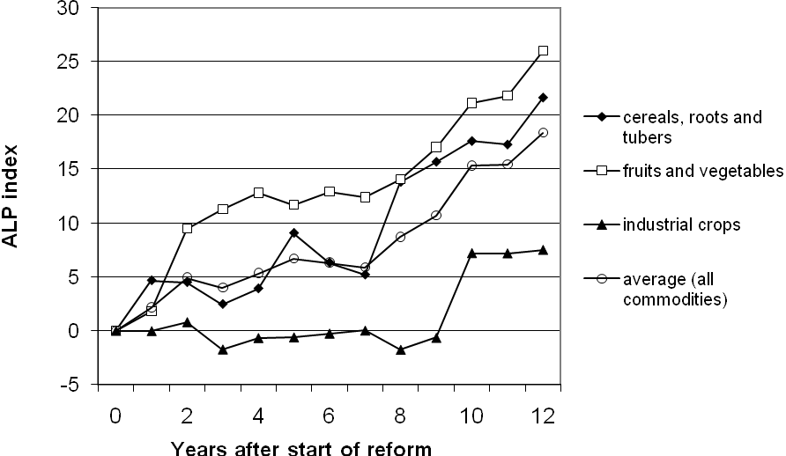
Changes in Agricultural Labor PRODUCTIVITY for Sub Sahara Africa across commodity types
Source: FAOstat

Slide 17
Hypotheses on commodity variations in SSA
  Cereals and tubers :
    Low value staple food crops
    State remains important in exchange & VC
    Private sector limited to spot market transactions
    Less disruptions because limited external inputs
  Industrial crops :
    Medium value traditional export commodities
    External inputs
    Shift from public to private VC
    Major contract enforcement problems with competition

Slide 18
Hypotheses on commodity variations in SSA
  Fruits & vegetables: Mixture of
    Low value for local market
    Low input
    High value, high input non-traditional exports
    Recent growth
    Entirely private sector VC organized
      (eg Minten et al, 2009; Maertens and Swinnen, 2009)

Slide 19
Increasing food standards
Increasing food standards in the past decade
  International food standards already laid down since the early twentieth century ...
    Codex Alimentarius (1960)
    International Plant Protection Convention - IPPC (1952)
    World Organisation for Animal Health – OIE (1924)
  .. but since the 1990s there has been a sharp increase in the proliferation and spread of food standards
    Increasing number of food standards
    Increasing complexity of food standards
    Increasing stringency of food standards
Notes:
19

Slide 20
Increasing food standards
Implications for developing countries?
  Standards affect trade and specifically the export opportunities of developing countries
  Standards affect the structure and governance of food value chain in developing countries
  Impact on development (economic growth and poverty reduction)?
Notes:
20

Slide 21
Comparative Analysis: 3 Cases
 | Small-holders | Industry structure | High value exports to EU
Madagascar green beans | 100% contract | Monopoly Local | yes
Senegal green beans | Mixed & changing | Competition Local | yes
Senegal cherry tomatoes | 0% | Monopoly Foreign | yes

Slide 22
Poverty & Smallholders
Smallholder participation is assumed to be good ex ante
Virtually all studies ignore labor market effects

Slide 23
1. Mada : Green Beans
Rapid growth over past decade
  1990: 100 farmers
  2005: more than 9,000 small farmers on contract
In 2004/5: 3,000 tons of exports
  90% put in jars and shipped by boat
  10% fresh and shipped by plane

Slide 24
Mada: Contracts in supply chain
Standard contracts for all farmers (individuals):
1 are
Fixed price over the whole year
Seeds, fertilizer, pesticides on credit (in kind), to be repaid
Multiple contracts possible over one year

Slide 25
Strict supervision of the farmers:
  300 extension agents on the payroll, each has six assistants; one assistant for 5 farmers
  Number of visits of farmers: 30% of farmers say less than once a week; 30% says once a week; 41% says more than once a week.
  92% of farmers say that firm knows approximately or exactly the number of plants on the plot!
High supervision costs to ensure quality but also to avoid ‘side-selling’

Slide 26
Contract motivations for vegetable farmers in Senegal and Madagascar
Notes:
26

Slide 27
Effects on technology adoption, income & land use (biodiversity)
Land use in the off-season on rice fields
Vegetable export contributes for 47% to household income
Rice productivity up by 64% through technology spillovers
Sharp improvement in food security
Reduced pressure on forests

Slide 28
Impact of vegetable contract-farming on the length of the “hungry” season in Madagascar
Source: Minten et al., 2009
Notes:
28

Slide 29
Effects on technology adoption, income & land use (biodiversity)
Land use in the off-season on rice fields
Vegetable export contributes for 47% to household income
Rice productivity up by 64% through technology spillovers
Sharp improvement in food security
Reduced pressure on forests

Slide 30
Senegal exports

Slide 31
2. Green beans in Senegal
% rural household participation

Slide 32
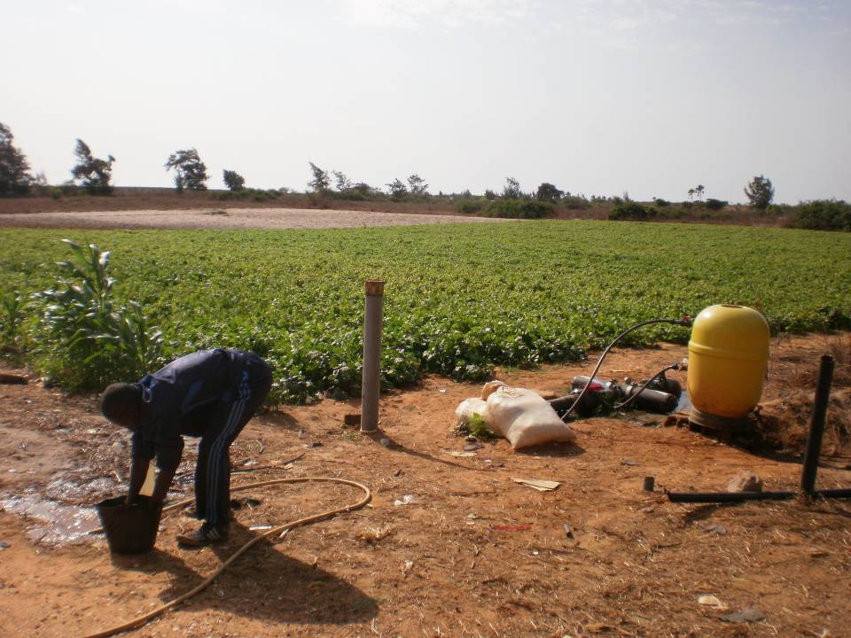

Slide 33
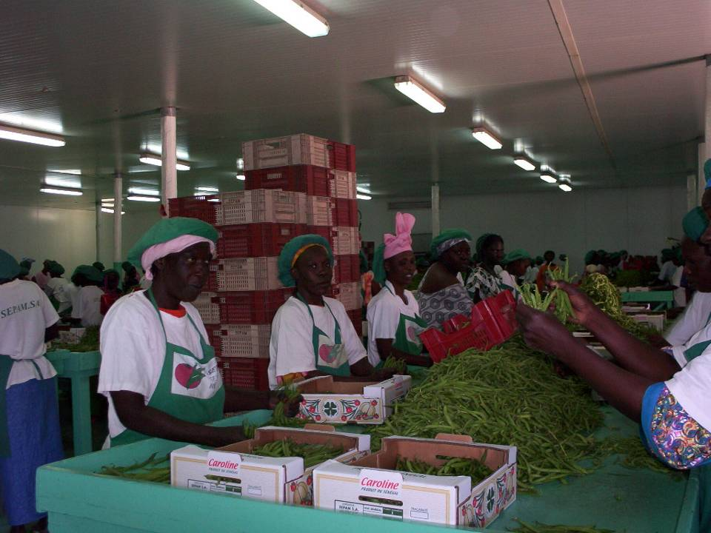

Slide 34
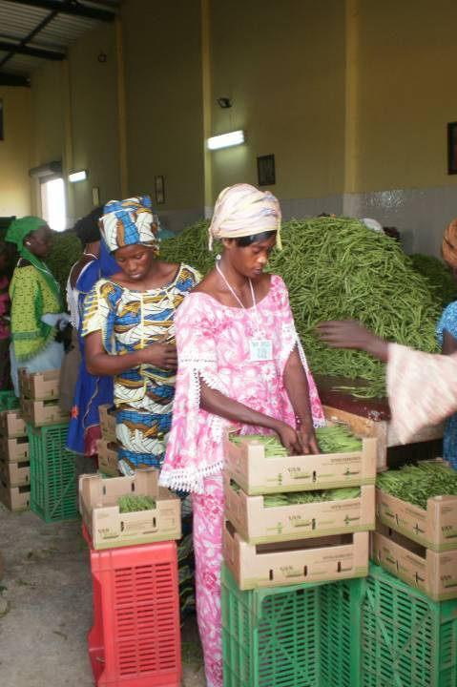
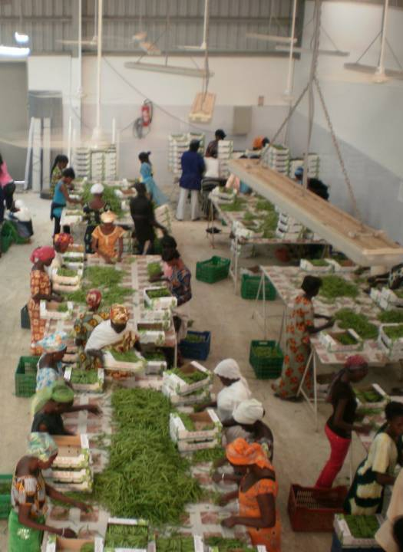

Slide 35
Income effects

Slide 36
Poverty effects
(Green beans in Senegal)
Source: Maertens and Swinnen, 2009
Notes:
36

Slide 37
3. Worst Case Scenario ? tomato export in Senegal
  Poor country
  FFV sector: Increasing standards (private and public)
  Extreme consolidation
  Foreign owned multinational company
  Full vertical integration
  Complete exclusion of smallholders
  FDI of land (“Land grabbing”)
Notes:
37
EU: marketing, labeling standards, health control
private food quality, food safety, ethical, environmental standards (ISO, EurepGAP, Tesco Nature Choice, …)

Slide 38
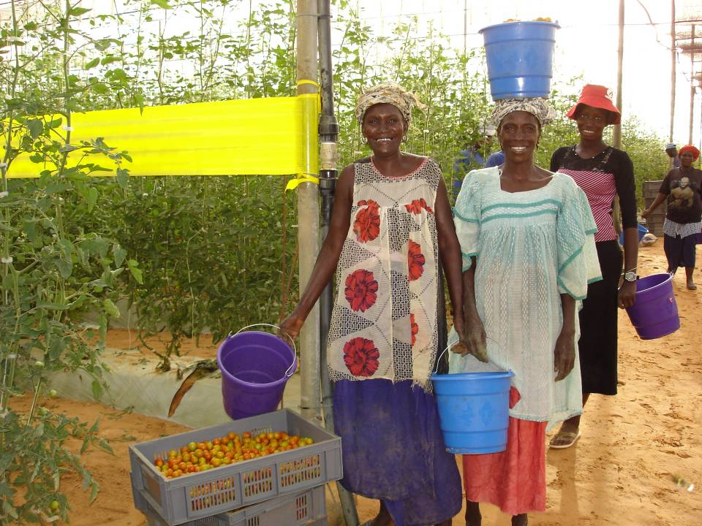
Notes:
38

Slide 39
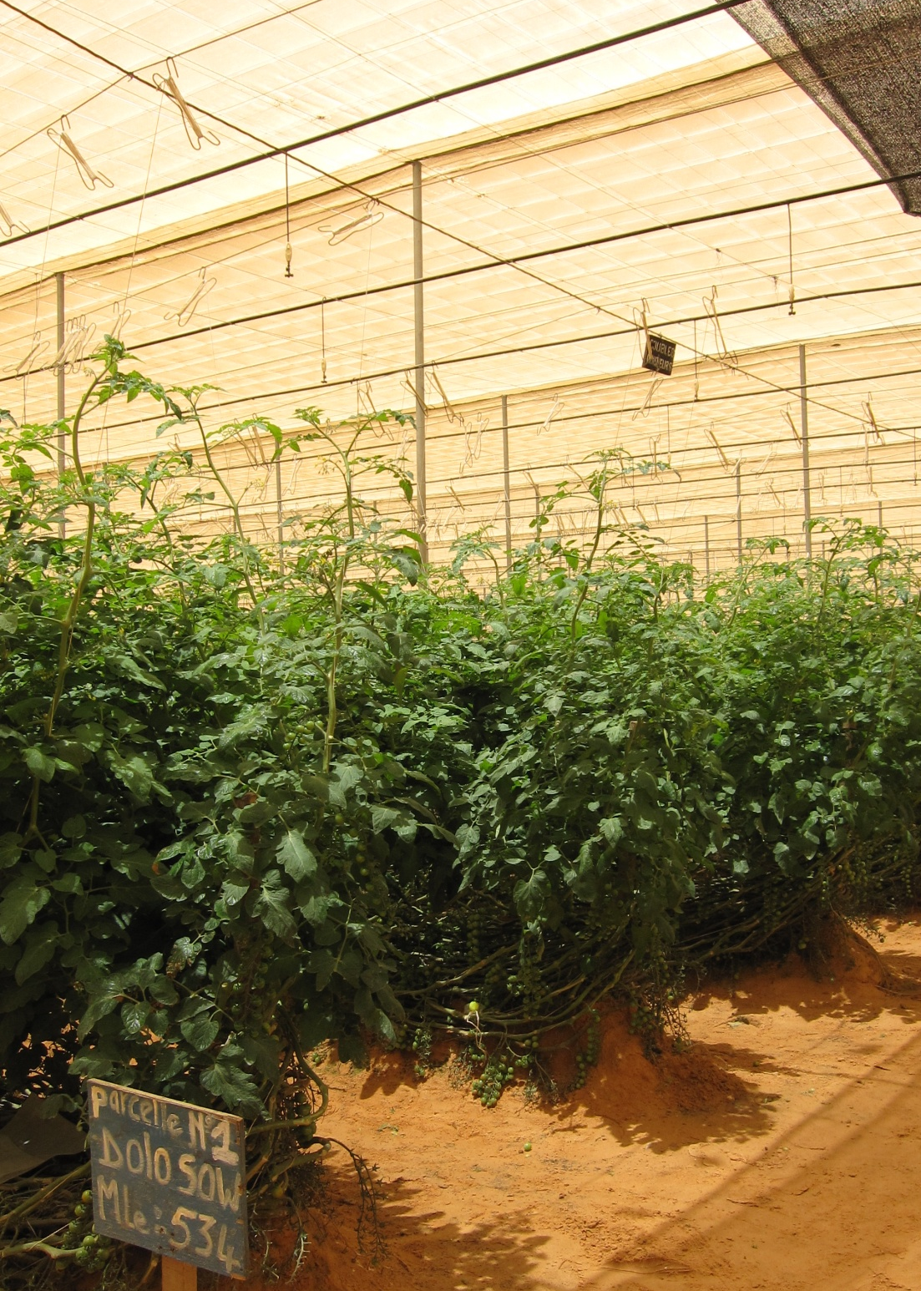
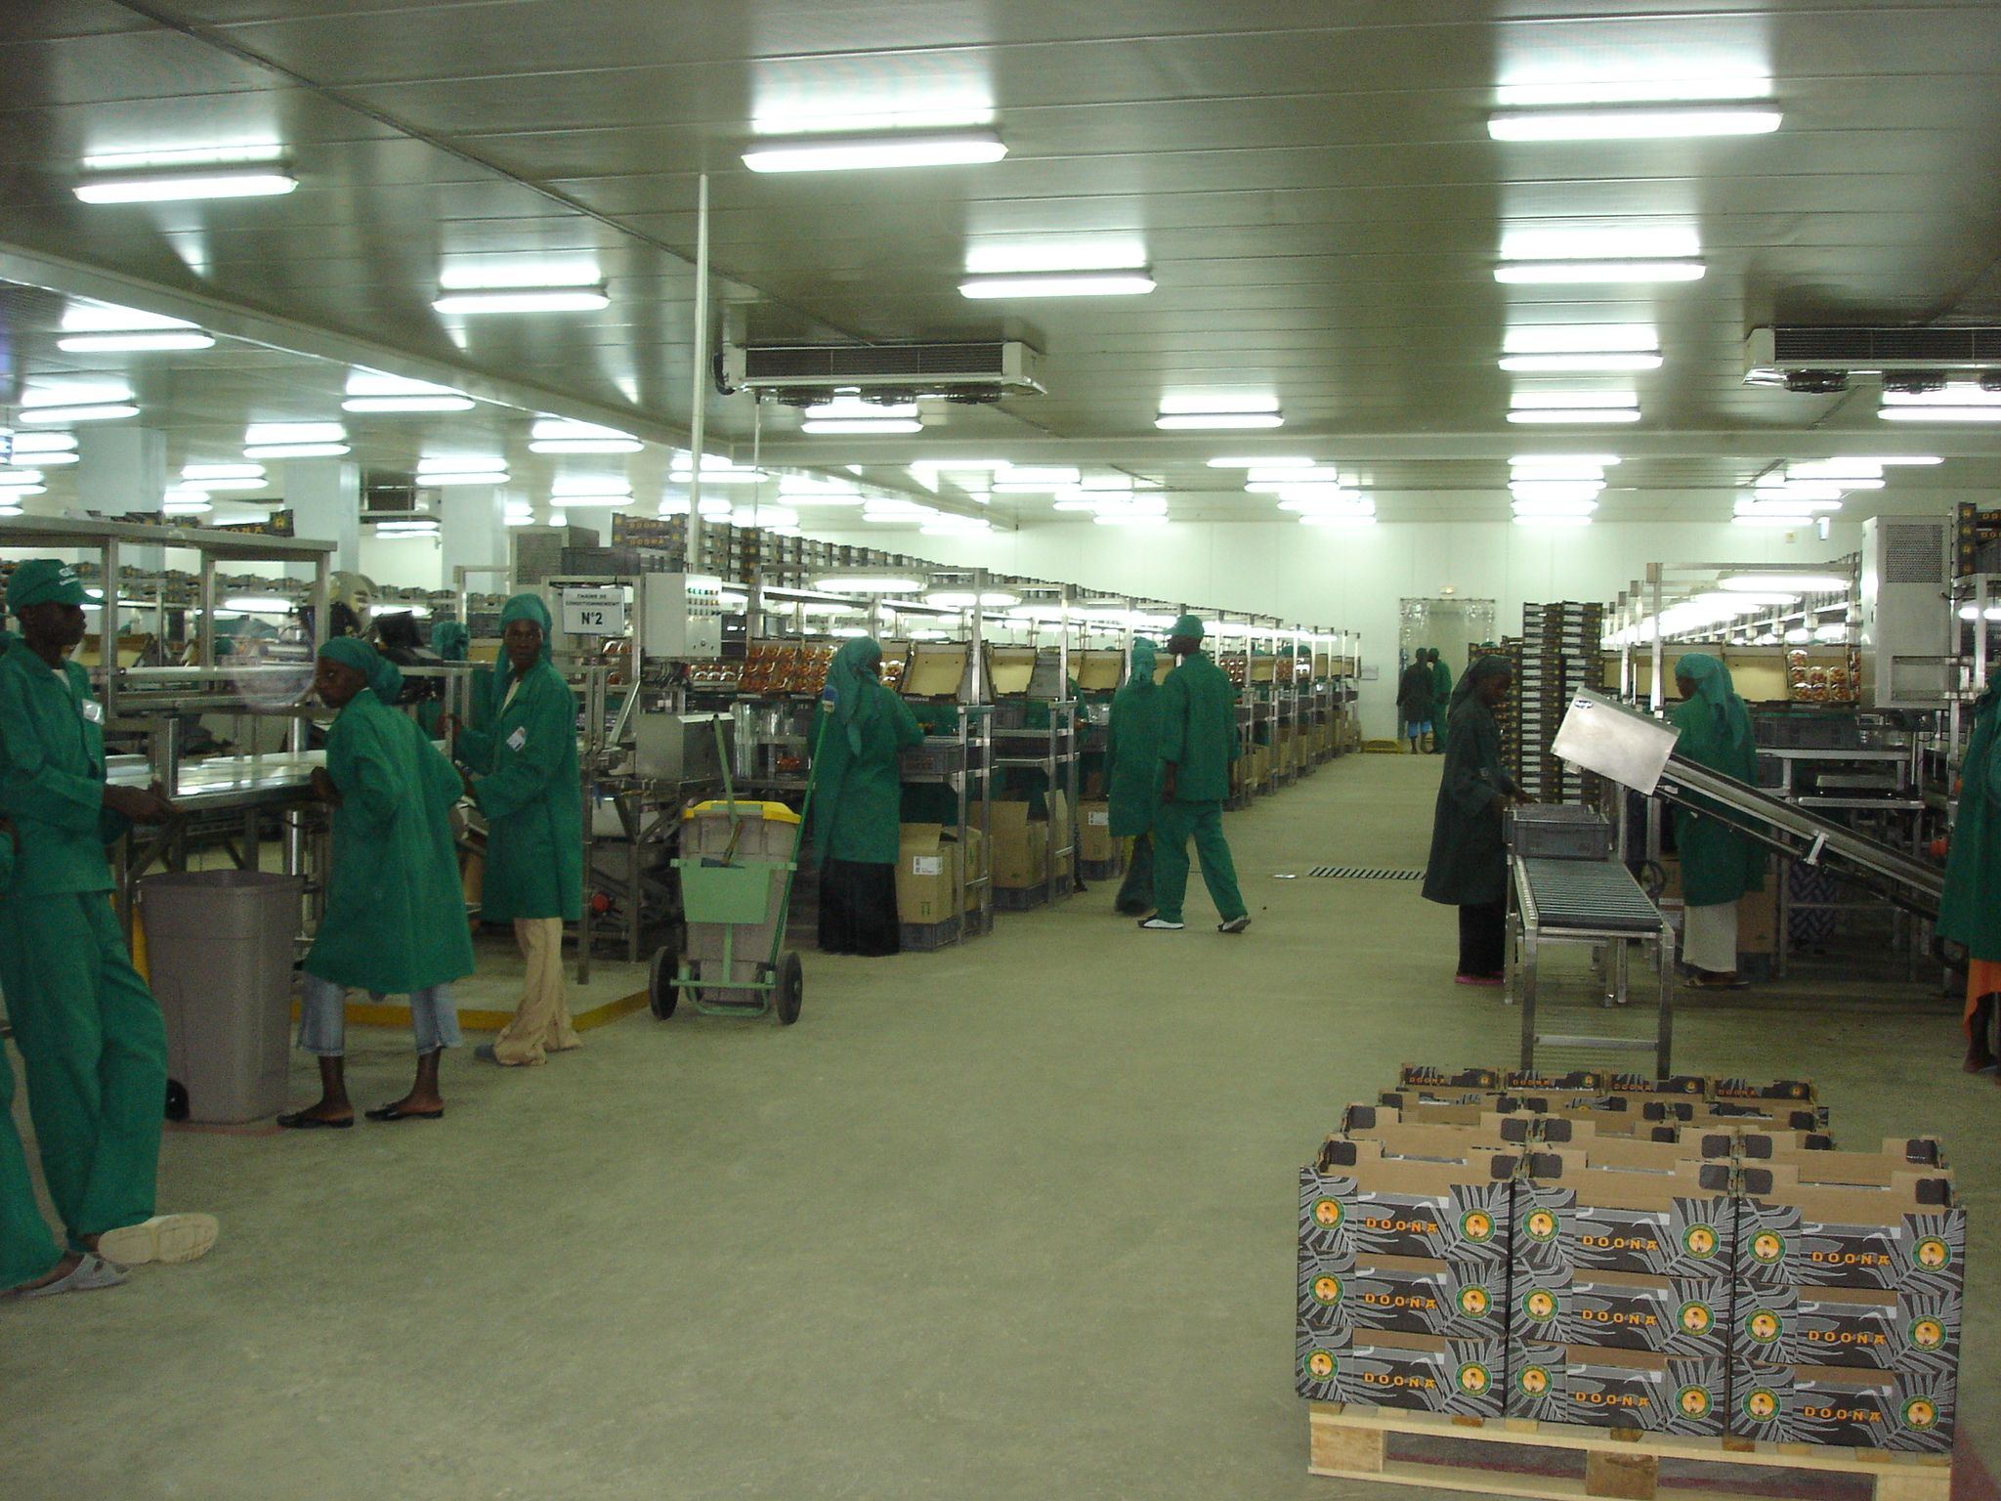

Slide 40
Notes:
40

Slide 41
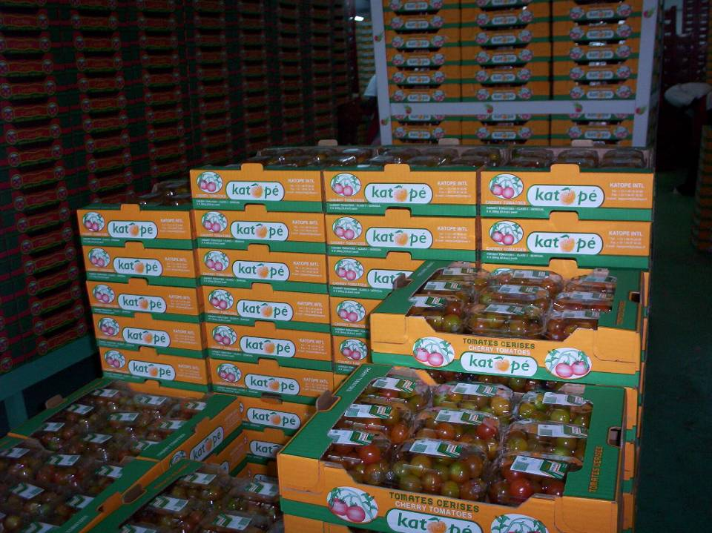
Notes:
41

Slide 42
Employment
More than 3000 workers in 2006
40% of HH in the region have at least one member employed by GDS
Notes:
42

Slide 43
Household participation
No bias of employment towards better-off or more educated households
Bias towards households with smaller per capita landholdings
Notes:
43

Slide 44
Income effects
Notes:
44

Slide 45
Poverty Effects
Poverty:
35% vs. 46%
Extreme poverty:
6% vs. 18%
Notes:
45

Slide 46
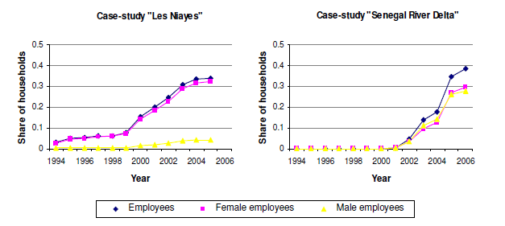
Gender effects
    Female employment in Senegal horticulture export sector
Source: Maertens and Swinnen, 2009
Notes:
46

Slide 47
    Importance of female income in total household income
Source: Maertens and Swinnen, 2009
Notes:
47

Slide 48
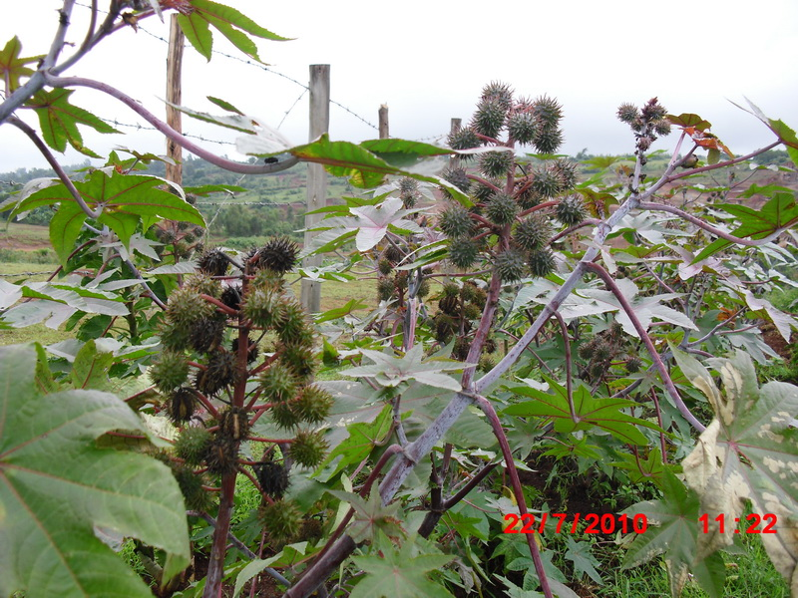
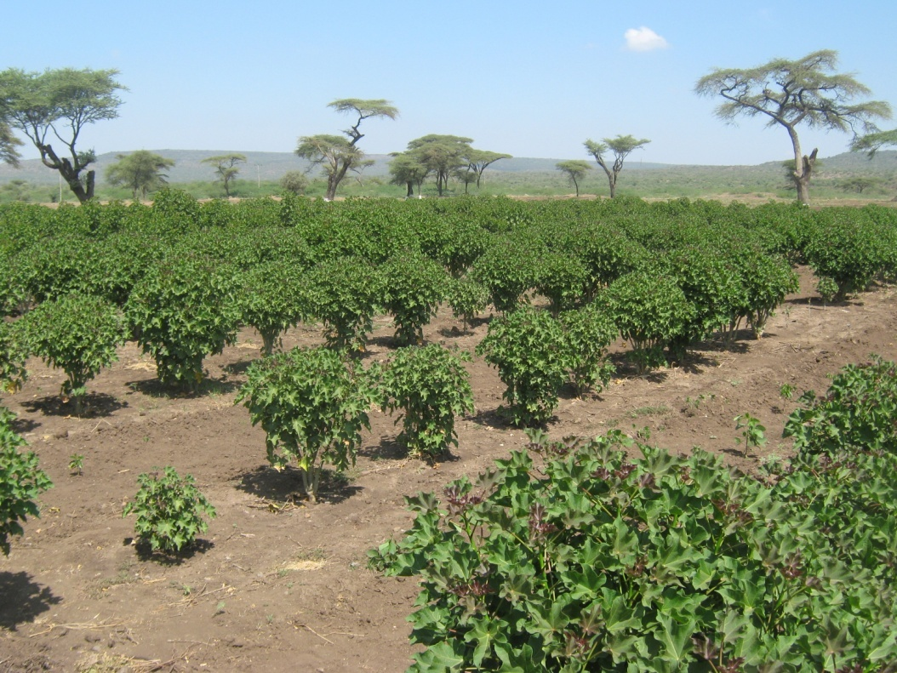
  BIOFUELS IN ETHIOPIA
  2 MODELS: Castor & Jatropha

Slide 49
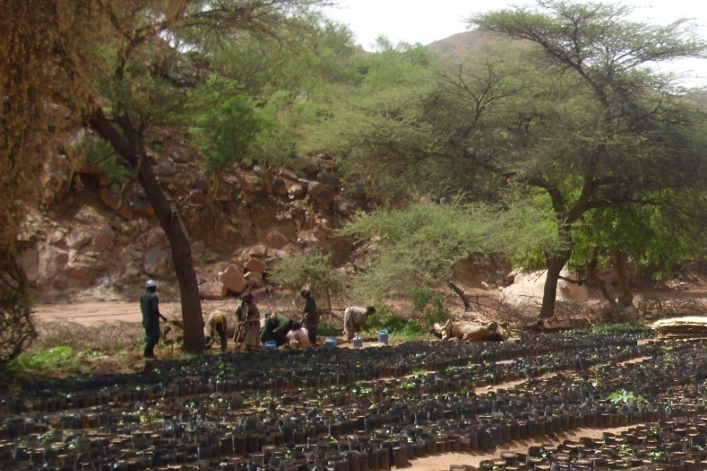
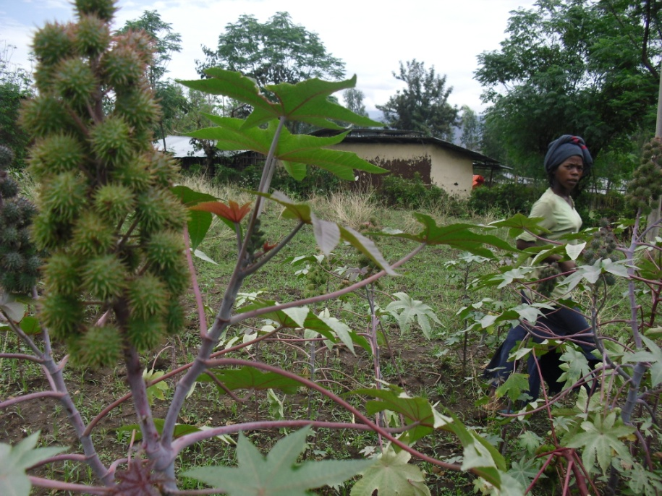
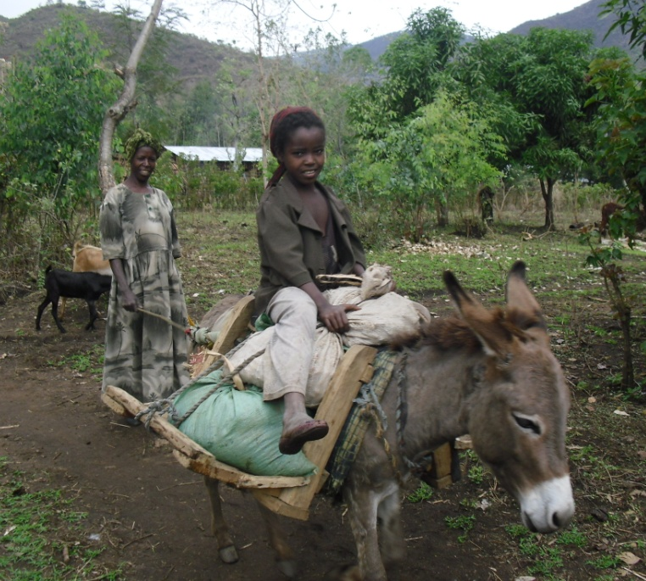
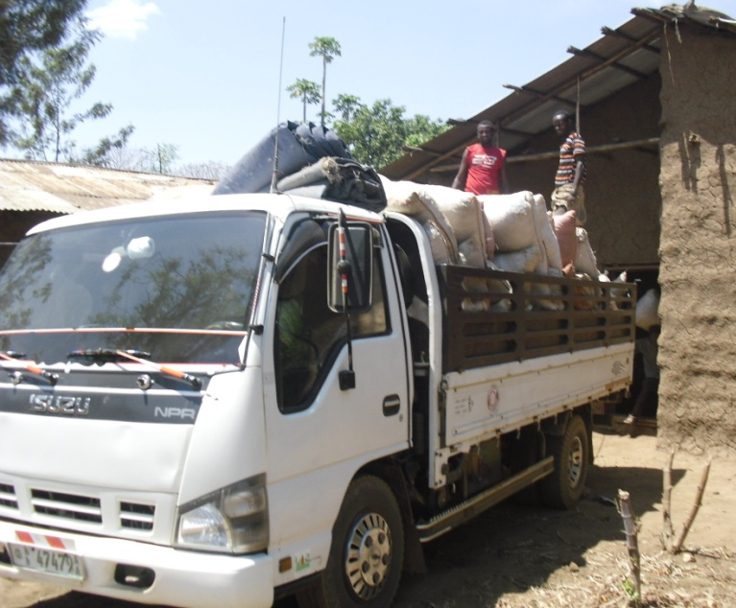
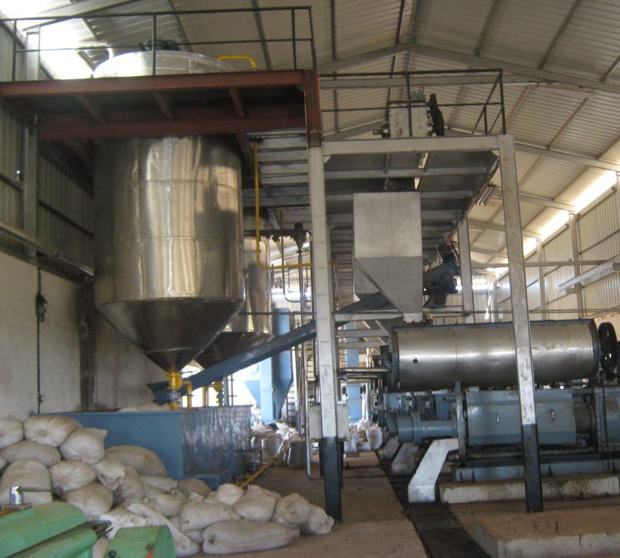

Biodiesel chains
nursery → seed collection → pealing →oil pressing →refining → oil export/use

Slide 50
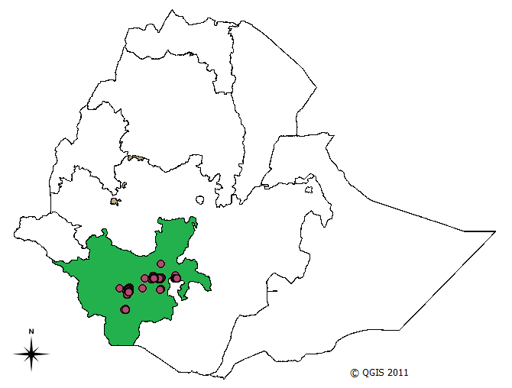
Study area – generally food insecure
Source: FEWS, 2010

Slide 51
Castor contract farming in the study area
foreign company contracting farmers to grow castor
farmers are eligible to participate –if own land size > 0.75 ha
farmers are advised to allocate only a maximum of ¼ of their total land to castor and keep traditional crops on the side
Castor seed has no other use in the area and has no other buyer
Farmers often use inputs to other crops – thus contract farmers may record potentially gain from higher input use

Slide 52
Preliminary findings
penetration of the Castor crop into inaccessible and remote places
significant adoption rate in few years of promotion contrasts with low rates of other technology adoptions
diversification of crops
sever seasonal food fluctuations are common – low production may follow bumper harvests

Slide 53
Preliminary results
Participants :
  adopters and non-adopters have no significant difference in age, dependency and labour force ratio composition and prevalence of polygamy, access to credit and government extension service
  they differ in asset/land holdings same
Comparison:
  Income is higher by 5-10%
  “Food gap” is lower by 50% (30 vs 47 days).
  fertilizer use is higher by 70%

Slide 54
…preliminary results
Effects:
  adopting biodiesel crop narrows the food gap days by 28% for adopters
this could potentially be attributed to
  direct effect of the piecemeal cash flow farmers received from piecemeal supplies nearby village level seed collection centers
  indirect effect of increased use of inputs and better agricultural practices and higher income from other side crops

